Slide 1

Cyclistic BIKE-SHARE
Google Data analytics Professional Certificate Capstone project
Prepared by: Murtaza Hussaini
June 26th, 2021

Slide 2
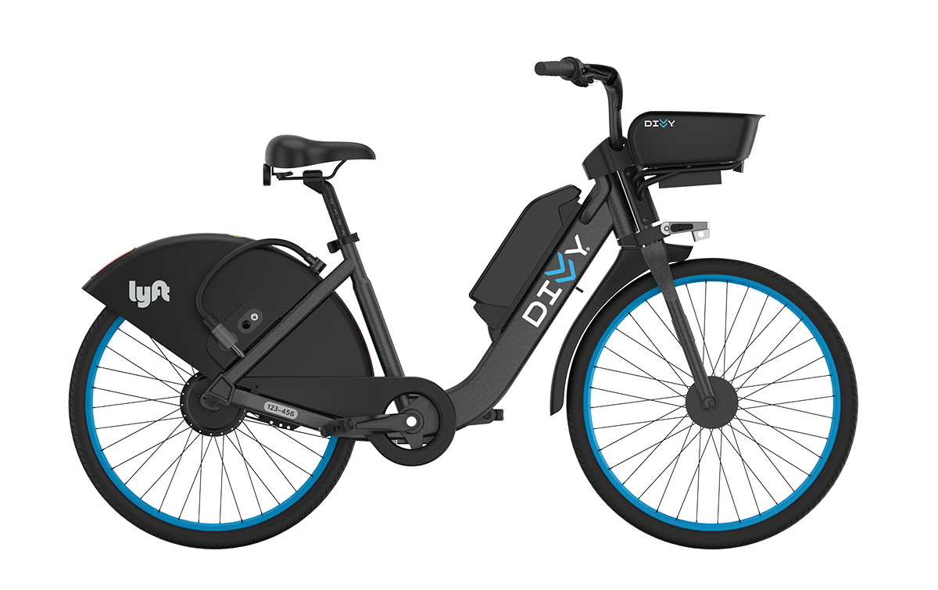
Contents
Introduction
Insights
Summary
Recommendations
Appendix

Slide 3
Introduction
Business Task
Finding how do annual members and casual riders use Cyclistic bikes differently?
The insights will later be used by marketing department team to design a new a strategy to convert casual riders into annual members.

Slide 4
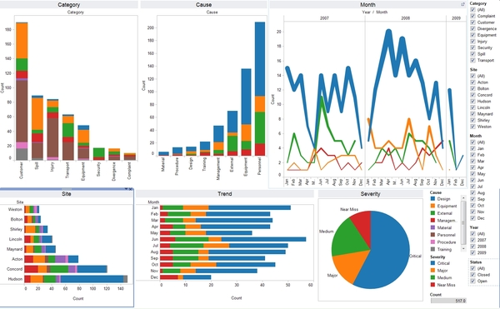
Insights

Slide 5
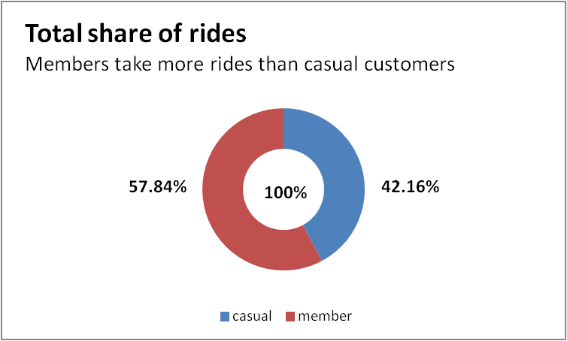
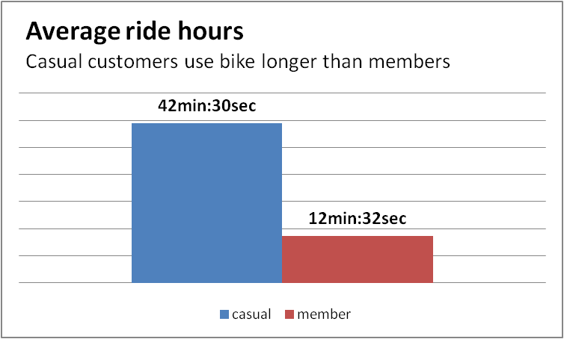
#1
Members take 15% more rides than casual customers.
But casual customers take 30(minutes) longer rides comparing members.
Therefore our bikes spend more time with casual customers than members.

Slide 6
#2
Casual customers are more active in summer. The members follow the same pattern too.

Slide 7
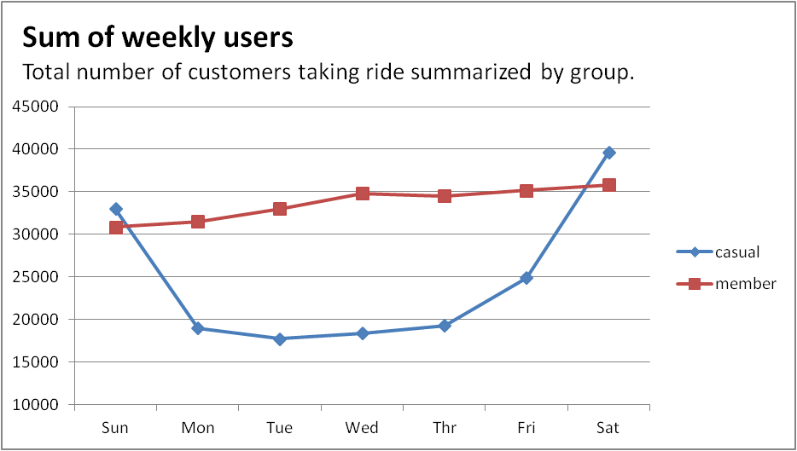
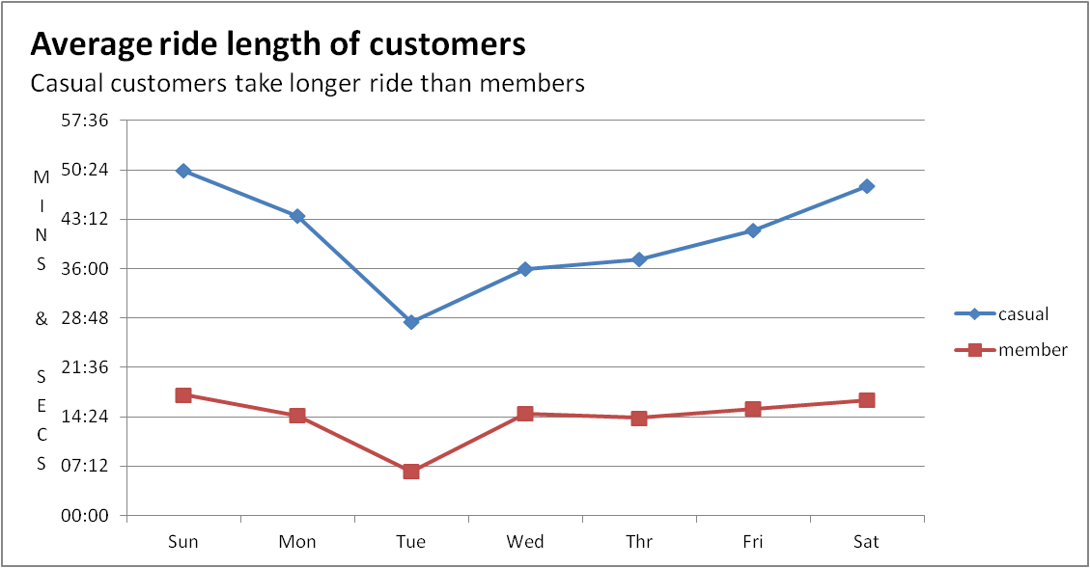
#3
Casual riders take more rides for longer period at the weekend.
Whereas Members take steady number of rides with steady duration of rides the whole week.
Weekends are filled with casual riders.

Slide 8
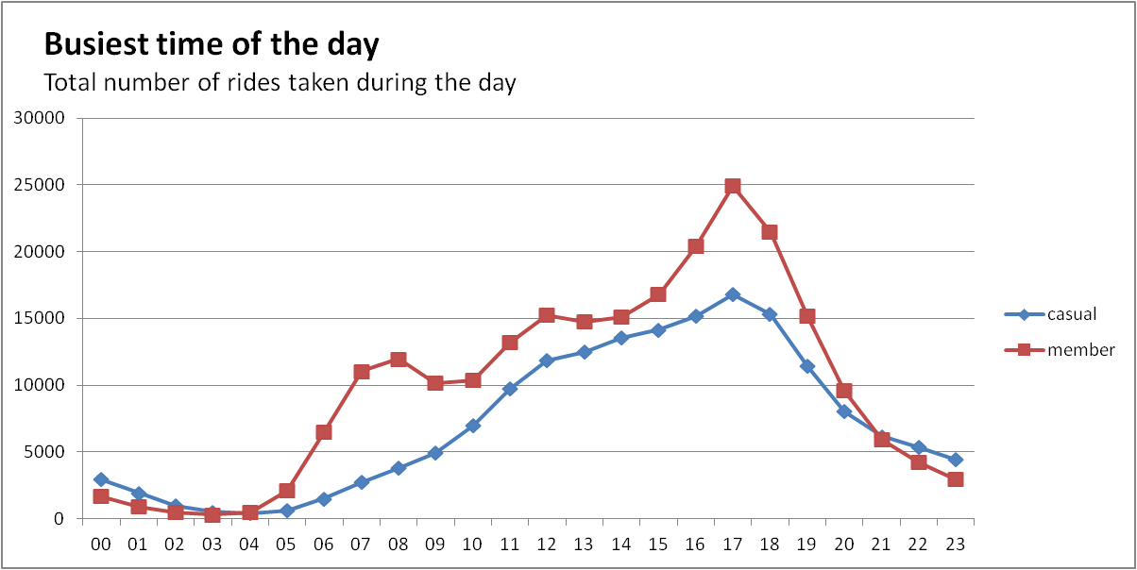
Members take more rides in the morning too unlike casual riders.
#4
Casual riders take more rides in the afternoon and evening (11-19).

Slide 9
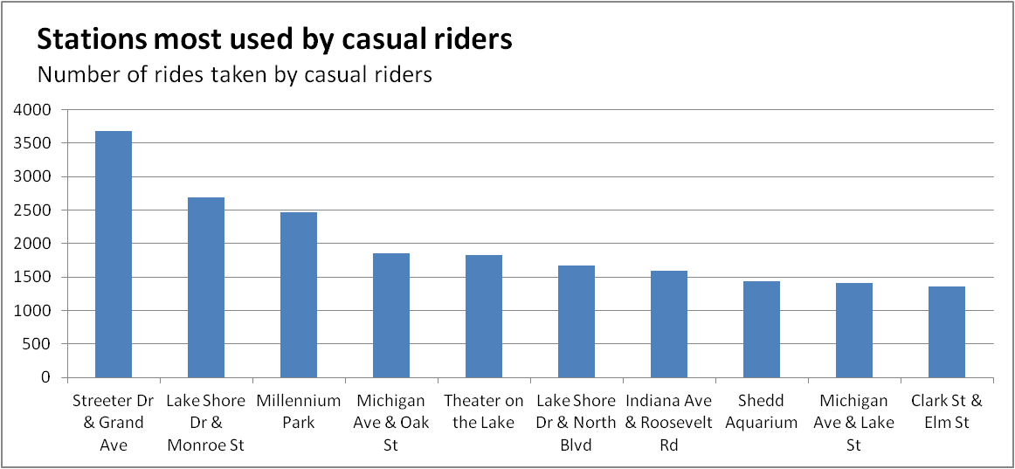
#5
These are the stations most used by casual riders.

Slide 10
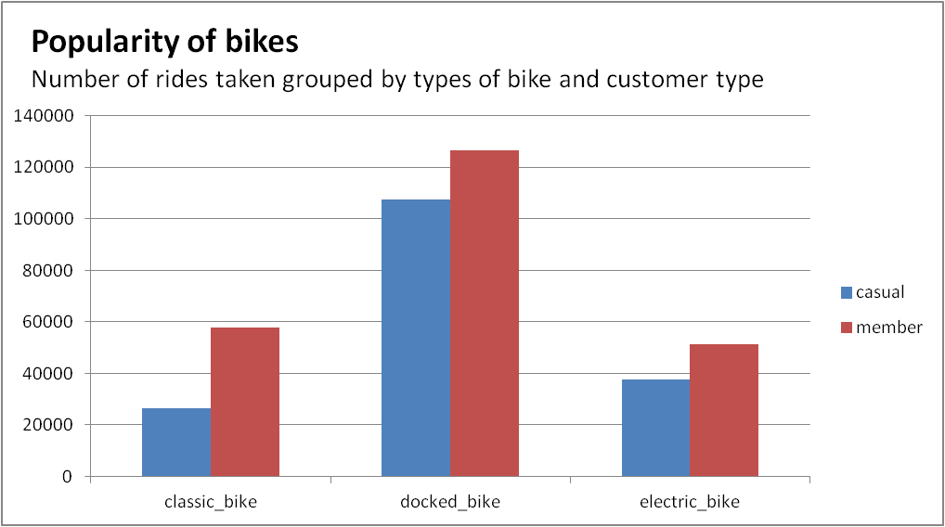
#Bonus
Docked bikes are most used by both casual riders and members.

Slide 11
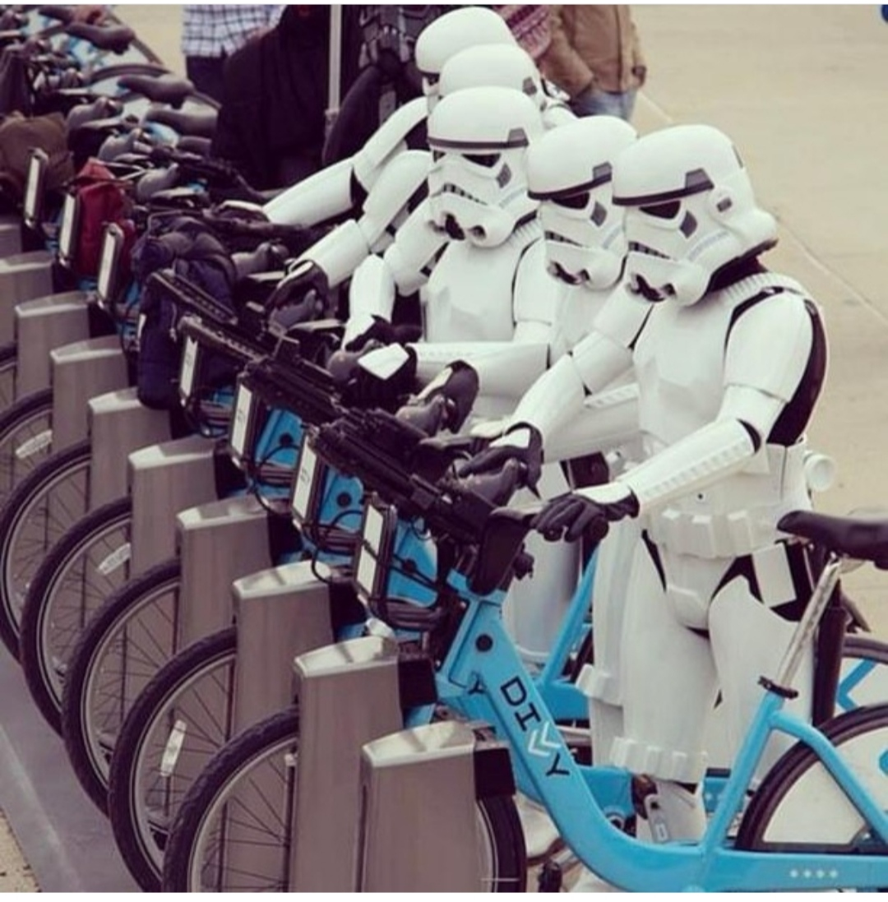
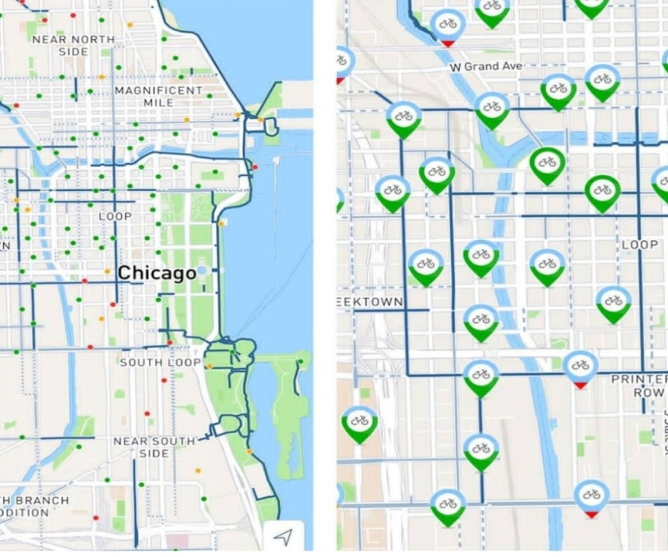
Let’s summarize and make actionable recommendations…

Slide 12
Summary:
Nearly 60% of rides are taken by casual customers
Casual customers take longer rides, our bikes are used daily:
  18 hours by casual customers
  6 hours by members
Casual customers use our bikes for leisure because:
  They are more active during summer holidays.
  They mostly use our bikes at the weekends.
  Their number spike up after working hour (11:19).
Popular stations and bikes among casual customers are:
  Stations: Streeter Dr & Grand Ave, Lake Shore Dr, Millennium Park
  Bike: Docked bike

Slide 13
Recommendations
The marketing team can design annual packages that include cheaper rate even for longer hours of ride.
Another annual weekend-only package can also be designed to target weekend riders.
The offer should be announced in summer when we have the most number of casual customers.
To get the most out of our marketing campaign, we can first target our busiest stations used by causal customers.

Slide 14
Thank you.

Slide 15
Appendix
The data used for this project is from Cyclistic’s historical data for last 12 months (June-2020 till May-2021). The data has been made available by Motivate International Inc. at this link under this license.
Due to limitation in computational power and efficiency purpose, I had to take random 10% of data which resulted in:
  Confidence level: 99.9% & Margin of Error: 0.2
The entire analyze process was conducted using R Programming. Data aggregation and other analysis is available in R script. Click here to view the R script file.
Photos are taken from instagram.com/divvybikes

